Slide 1

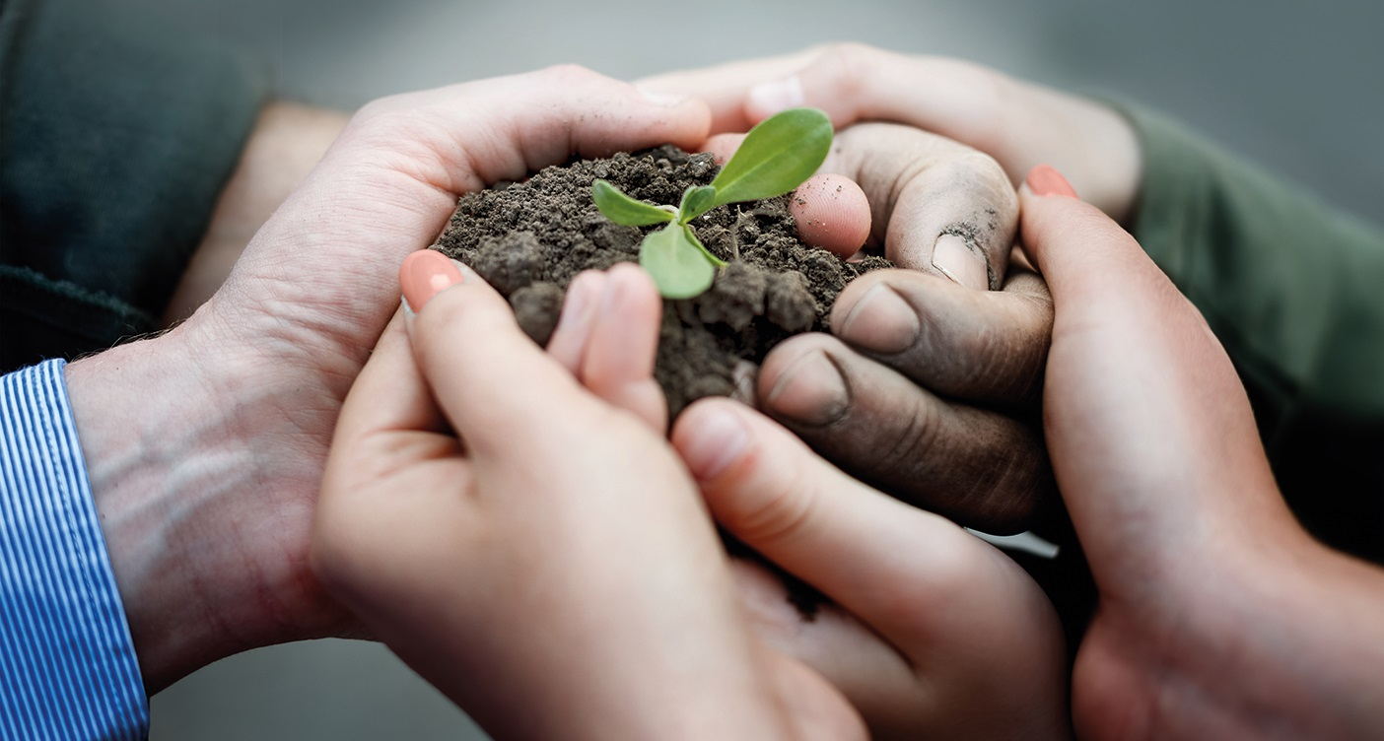

The European Innovation Partnership EIP-AGRI:
catalysing innovation for productive and sustainable agriculture and forestry
Conference “EIP Operational Group projects in Latvia”
Margarida Ambar, EIP-AGRI Service Point
Jelgava, Latvia, 31 October 2018

Slide 2


EIP-AGRI: bridging practice and research in agriculture and forestry
Research needs
Operational Groups
Farming
Forestry
Agribusiness
…
Research
Knowledge and partners
Ideas to test in practice
Multi-actor projects
Thematic networks
Notes:
the ‘bridge’ and interaction between practice and research

Slide 3

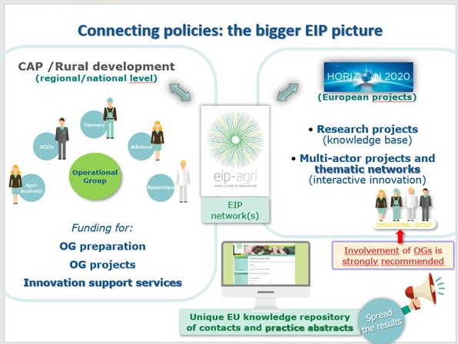
The bigger EIP-AGRI picture
Notes:
Total = 3.235
Italy 625

Slide 4
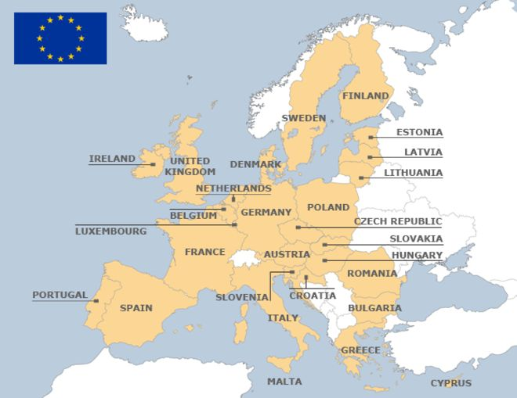

Calls for Operational Groups (OG)
(informal state of play Sept 2018)
1st call for OG projects to open soon
1st call for OG projects
now open
OG projects finished, selected and/or being evaluated
Notes:
Romania and Croatia already had a call for 1st step / setting up, but not Bulgaria nor Slovakia (Sept 2018).
Hungary?

Slide 5
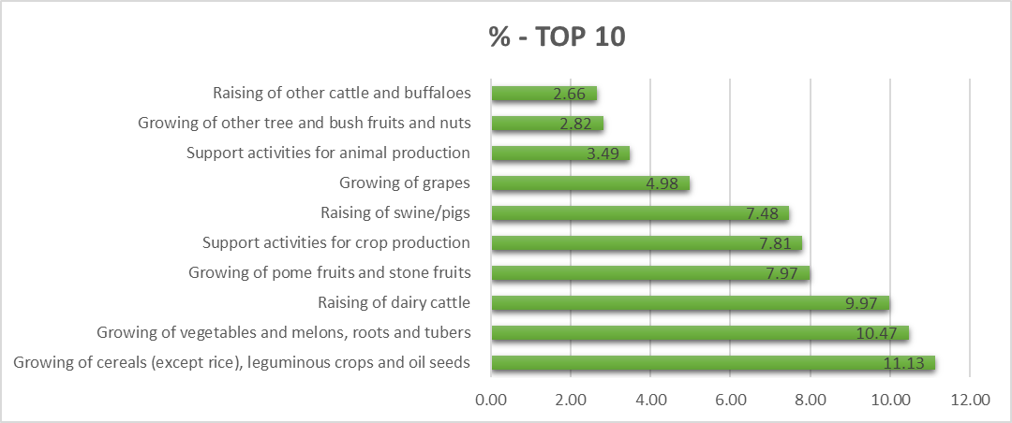
OG projects: assessment 2018 some preliminary results
  Product / sector ranked by occurrence
  (600 OG projects, 14 MS)
Source: OG assessment, by IDEA, Sept 2018, provisional results

Slide 6
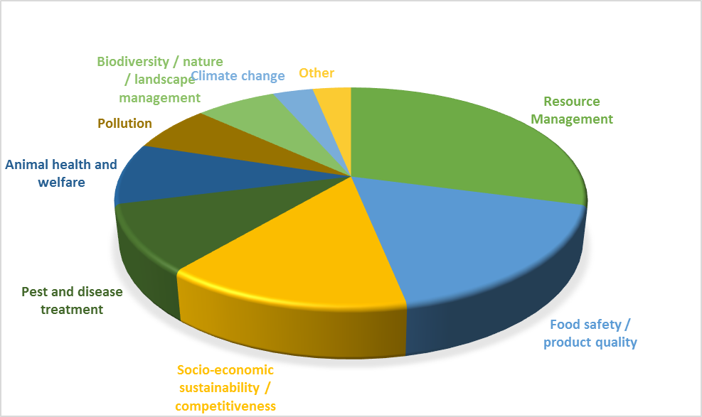
OG projects: assessment 2018 some preliminary results
  Type of agricultural Challenge / Opportunity faced
  (600 OG projects, 14 MS)
Source: OG assessment, by IDEA, Sept 2018, provisional results

Slide 7
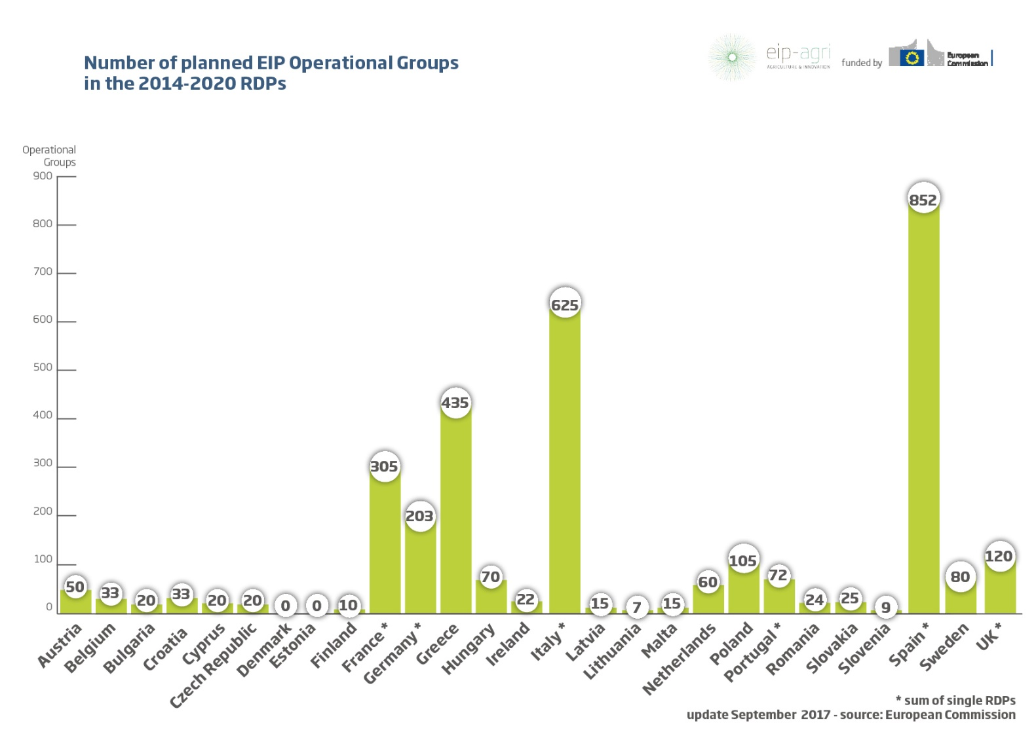
CAP / RDP – Operational Group projects
Number of planned EIP Operational Groups
(update Set 2017)
* Sum at national level
Notes:
Total = 3.230
Finland 10

Slide 8
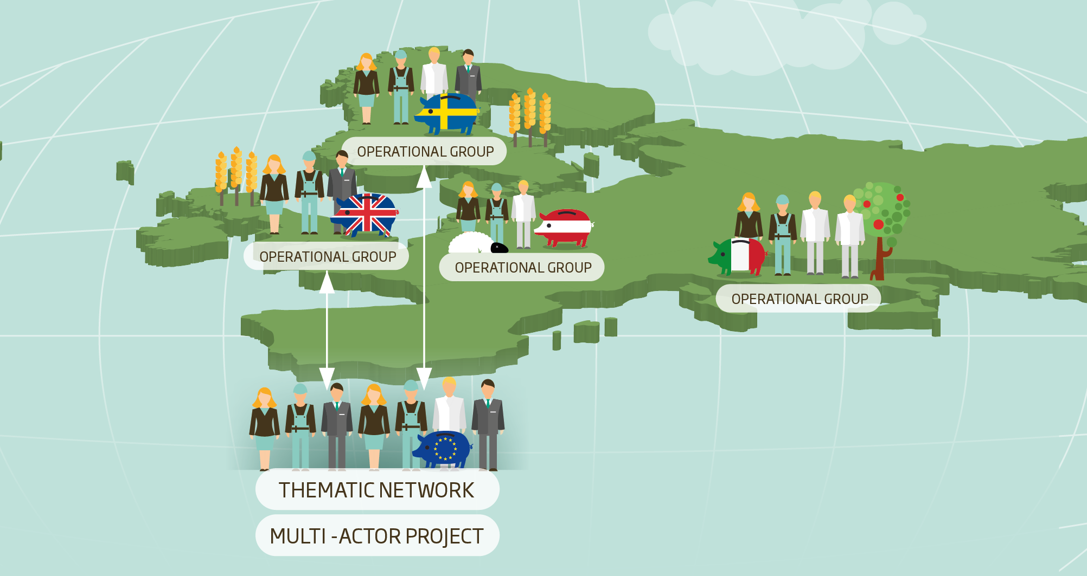
The EIP-AGRI Network: connecting people
& sharing knowledge to tackle challenges
Notes:
The EIP AGRI network is open to everyone with a keen interest in innovation for sustainability and productivity in agriculture and forestry. The Operational groups, multi-actor projects and thematic networks mentioned before are all key building blocks for the network. The network is not limited to these key building blocks; it is an open network; please feel free to join by registering on the website or for the newsletter.

Slide 9
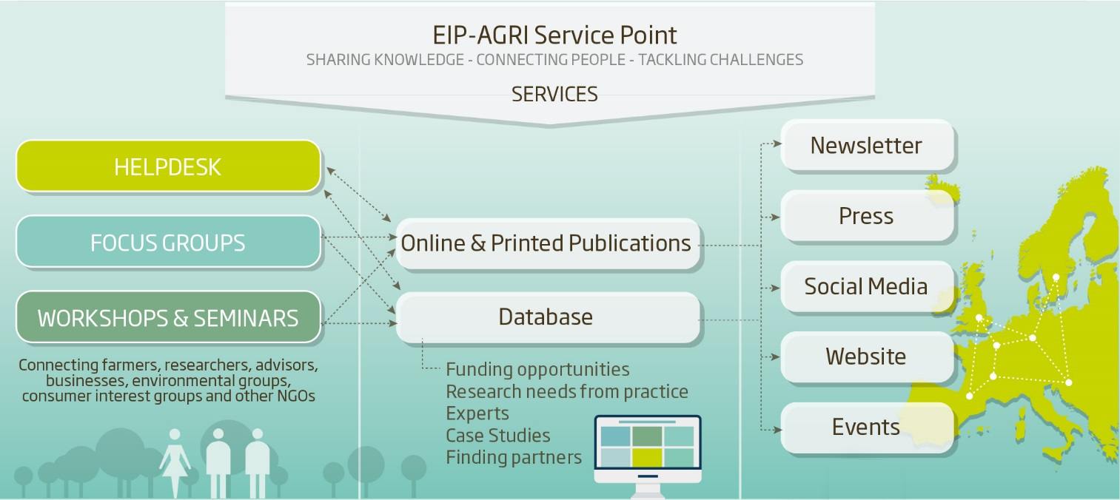
EIP-AGRI Network
Sharing Knowledge – connecting people – tackling challenges
Notes:
The European commission established the EIP AGRI service point in April 2013.
The main aims of the Service Point are (1) to connect people and facilitate innovation and knowledge exchange in agriculture and (2) to build bridges between science and practice.
EIP AGRI SP act as a mediator within the EIP AGRI network improving communication and cooperation between stakeholders
It plays the role of helpdesk- We are available to provide information or questions such as: Funding opportunities, Upcoming events organised by EIP-AGRI, Information on Operational groups and many others issues related to EIP AGRI.
For this : The EIP-AGRI Service Point organises events like Focus Group, Workshops, Seminars
And inform you through the newsletter, press, social media, website and events

Slide 10




EIP-AGRI Focus Groups, tackling agricultural challenges
Priorities for innovative actions
Ideas for Operational Groups
Exchange practical knowledge
Research needs from
practice
Propose projects to test solutions
Notes:
as part of our regular activities, we are promoting Focus Groups, dealing with existing agricultural challenges.
These FG have the objectives of:
taking stock of the state of the art of practice and of research + identify needs from practice for further research and propose priorities for innovative actions
FG bring together Practice and Research - excahnge practical knowledge -
identify priorities for innovative actions, generate ideas for operational groups, identify research needs from practice and suggest projects to test solutions.

Slide 11
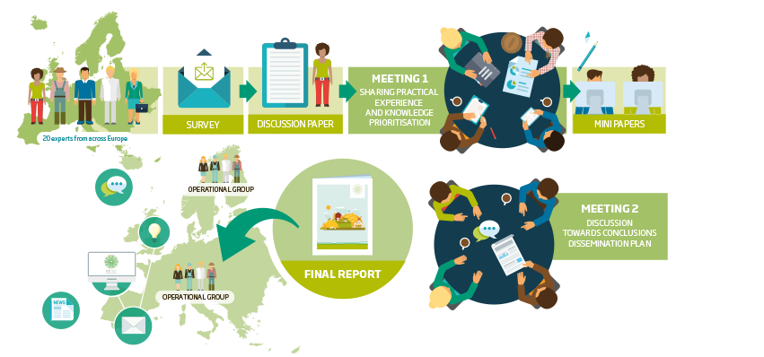
EIP-AGRI Focus Groups

Slide 12
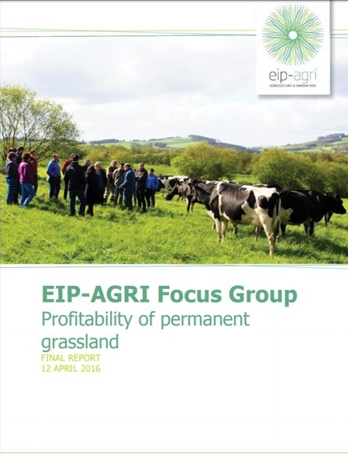
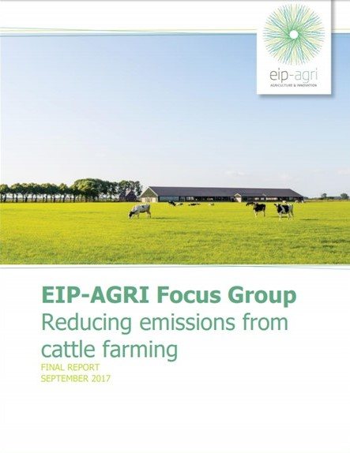
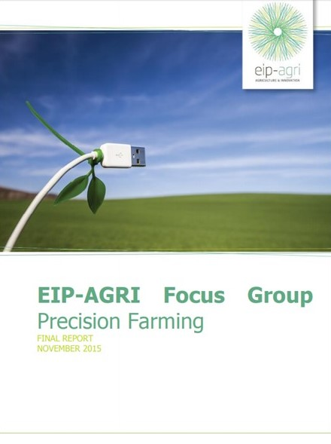
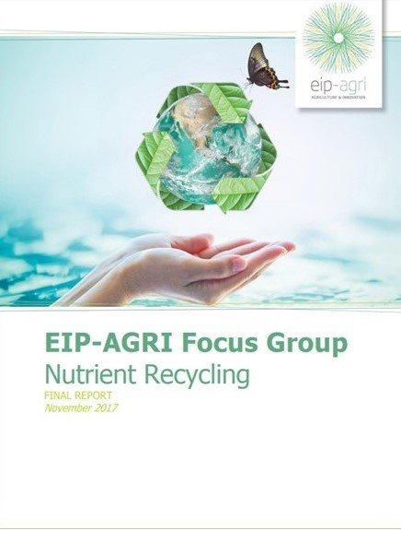
Examples of FG reports
Suggestions on topics for new FG

Slide 13
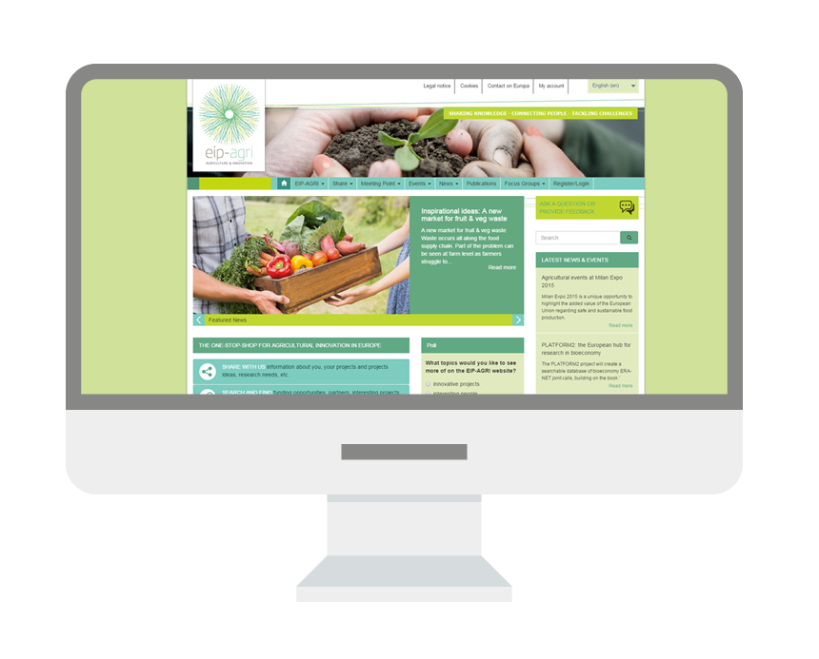
EIP-AGRI website www.eip-agri.eu
Notes:
the website and database are still under development,
Associated to the website, a database will become available for all EIP-AGRI actors.
This interactive platform - get information about: research projects and innovative initiatives, find out research needs from practice, find partners, look for online sources of info, etc.
The link (header)

Slide 14
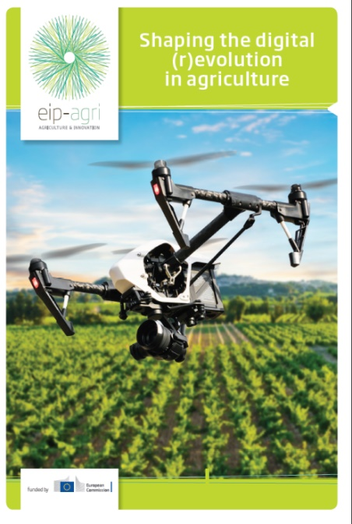
Information online - Publications
Notes:
Innovation support services
Agrinnovation magazine
EIP-Agri Service Point
EIP_Agri Network
EIP_Agri Operational Groups
Funding Opportunities – Horizon 2020
Funding Opportunities – Agriculture, Food & Forestry
Organic Farming – Optimising Arable Yields
The case studies are generated from the interactive platform on the website: by sharing your results on the website you will have a good opportunity to:
Disseminate good innovative projects
Promote innovative results that can help to make agriculture and forestry more sustainable
What do you want to see us write about? Make suggestions through the website, and tell us what’s useful for you.

Slide 15
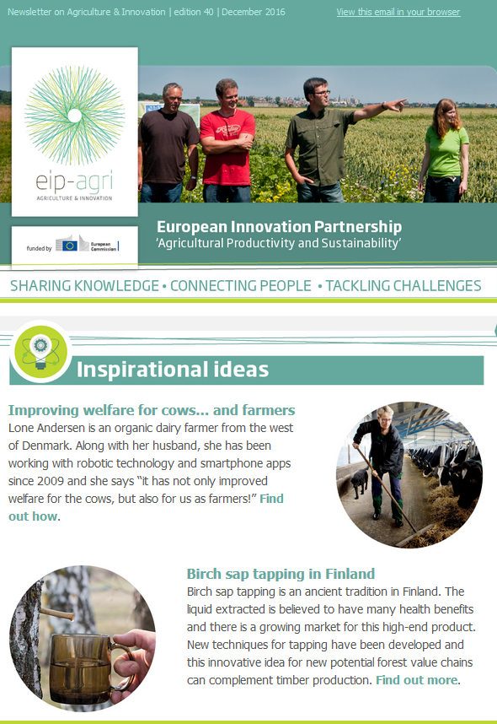
Monthly email
Newsletter
EIP-AGRI Service Point activities
EIP-AGRI Network activities and results
Funding opportunities
Link to the event calendar
Inspirational ideas
http://ec.europa.eu/eip/agriculture/en/content/subscribe-newsletter

Slide 16
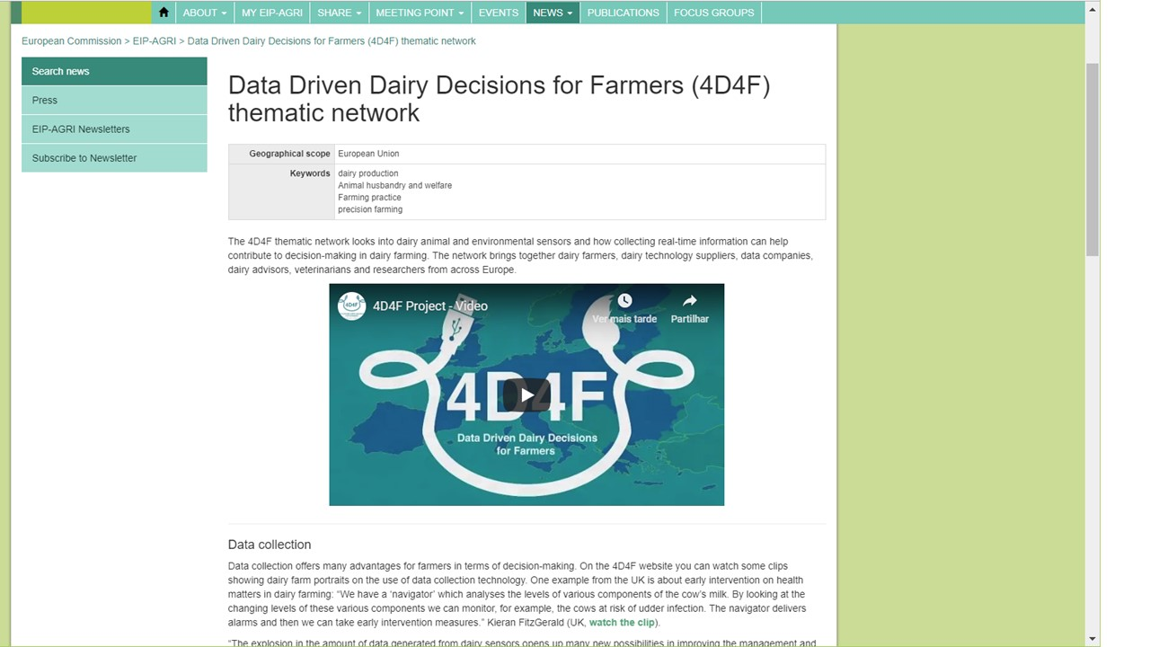
Inspirational ideas
E.g. H2020 Thematic Network 4D4F
Thematic Network: collecting real-time information; support to decision-making in dairy farming
The network brings together dairy farmers, dairy technology suppliers, data companies, dairy advisors, veterinarians and researchers from across Europe

Slide 17


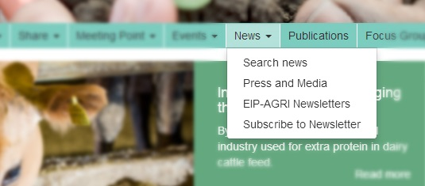


Information online
News
Events
Subscribe to our monthly newsletter
Read past newsletters
Search press articles and press releases
Information on workshops, Focus Groups and other events organised by DG AGRI
European calendar – upcoming events related to the EIP network
Notes:
Advertise your events
Look for speakers
Find contacts across borders
Share news

Slide 18
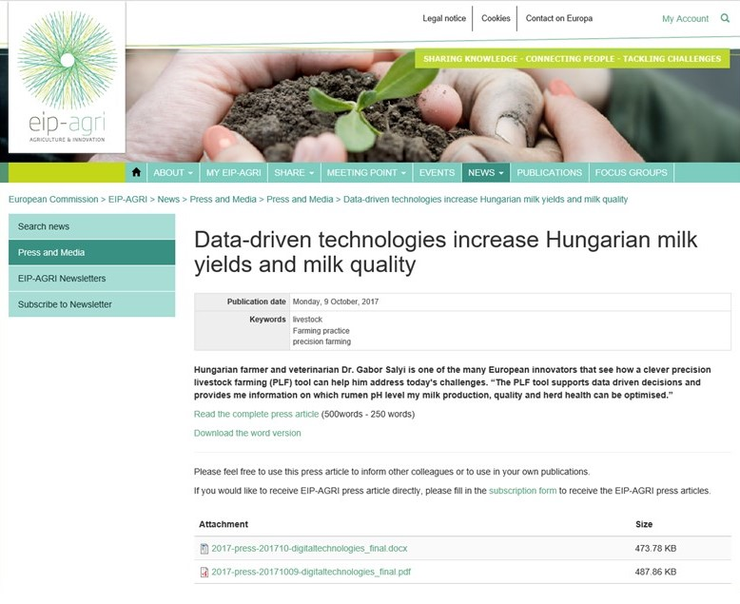
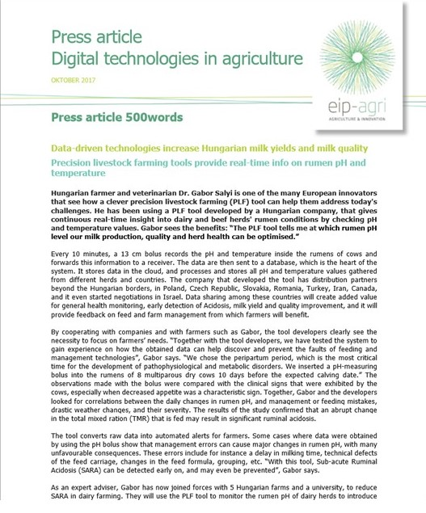
News (press article)
E.g. Data-driven technologies increase Hungarian milk yields and milk quality
“Data sharing among these countries … will provide feedback on feed and farm management from which farmers will benefit.”

Slide 19
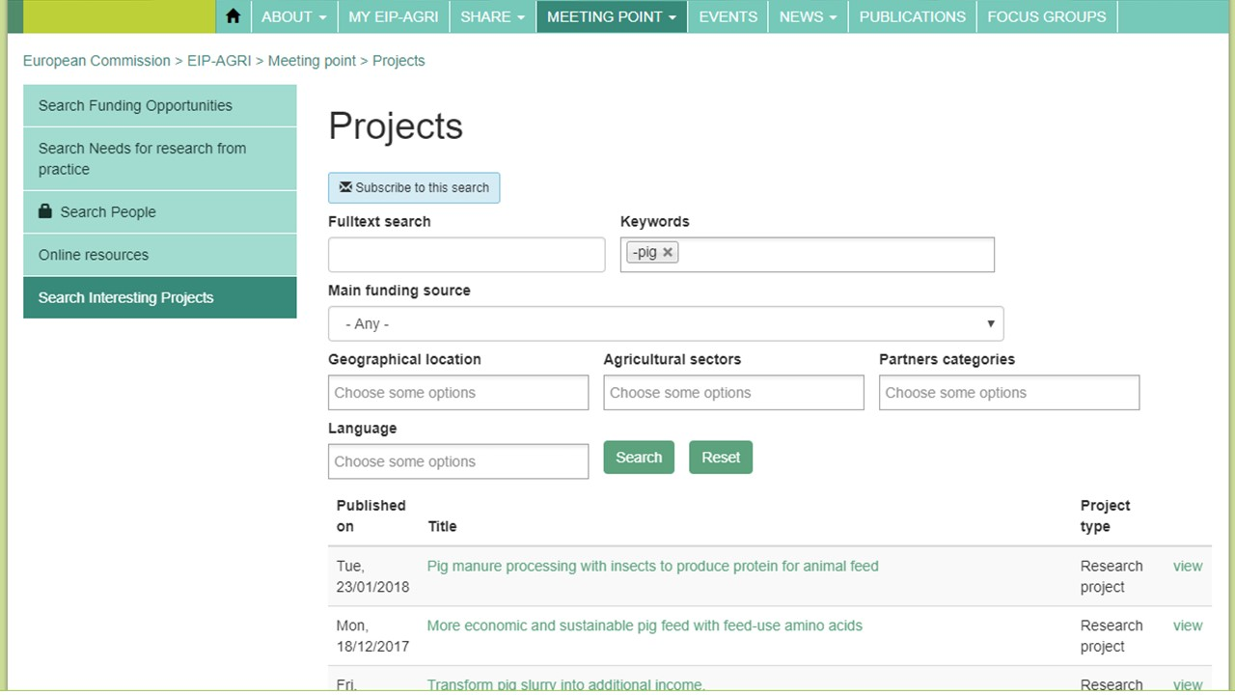
Meeting Point - Interesting projects
E.g. search by keyword
E.g. select keyword: ‘pig’
13 projects
E.g. dairy farming, dairy cattle, dairy production
14 projects

Slide 20

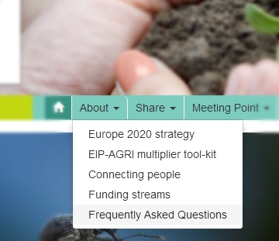

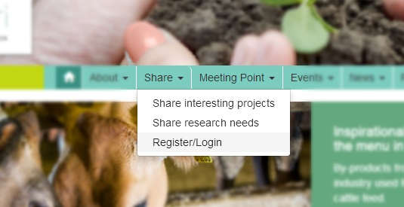
Get involved
Register on the website , explore, make use of available tools
Frequently asked questions
Ask a question or provide feedback
Notes:
Make sure your people register.

Slide 21
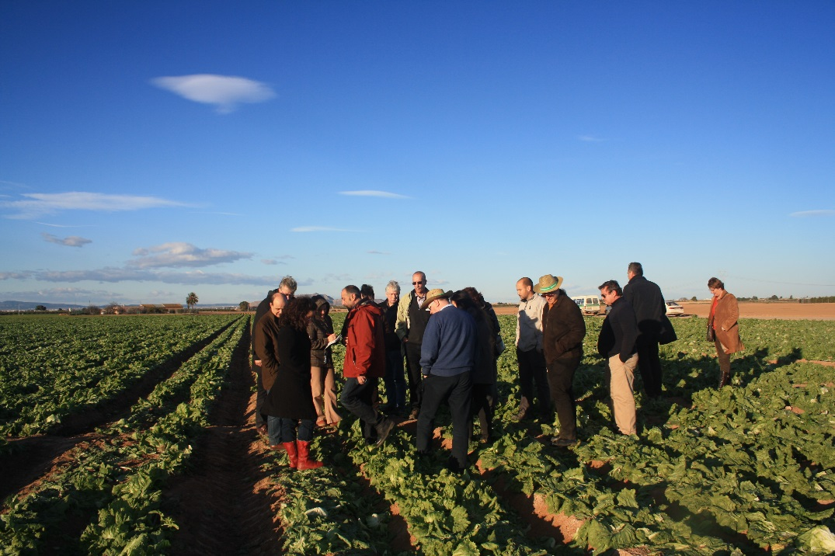
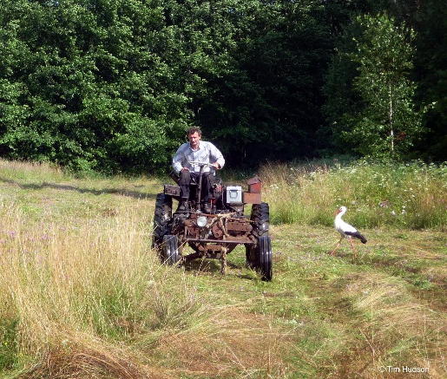
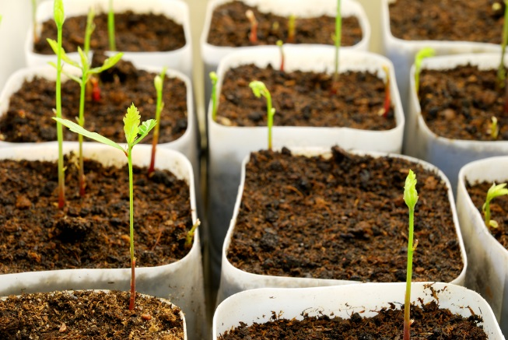
Get involved
Benefits for Operational Group partners
How can OG partners benefit?
  Get to know - other innovative ideas, solutions and inspiring examples
  Access - information about projects on the same / complementary topic
  Find people - working on the same / complementary topic
  Create awareness - on your project
  Disseminate - your project results
  Access - a wide selection of tools
  Share – your research needs

Slide 22

Operational Groups – get connected
Benefit from the interactions – collaborate!
Collaboration can take multiple forms:
  Informal - emailing, phoning, meeting, etc.
  Formal – cooperation agreement, protocol, etc.
Collaboration can be with varied entities, such as:
  Amongst Operational Group projects
  With individuals (farmers, advisers, researchers, etc.)
  With H2020 projects (Thematic Networks, multi-actor projects)
Collaboration in your own country/region or cross-border
OPERATIONAL GROUP
Notes:
Are built around concrete innovation projects targeted towards finding innovative solutions for a specific challenges or new opportunities
Require combination of different competencies (practical and scientific)
Are "hands-on" groups and are composed by those innovation players relevant for the project
Benefit from the interactions between the participants of the group and the sharing of the respective expertise

Slide 23
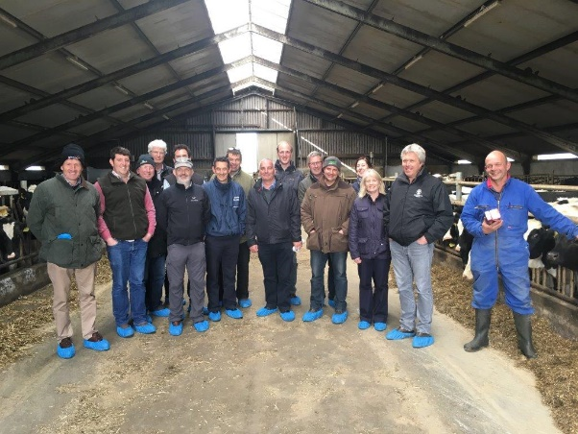
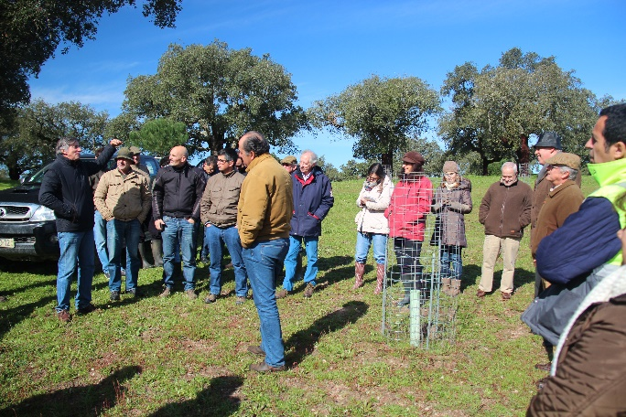
Operational Groups - collaboration
More information: see our brochure ‘Operational Groups - Collaborate to innovate’
TN EuroDairy - share knowledge, innovation and best practice in dairy farming across the main milk producing regions of Europe; aims to connect with 42 Operational Groups
PT OGs dealing with cork-related issues – meet, share activity plan, look for ways to cooperate
One of those OGs (UNDERCORK), established a cooperation protocol with a Spanish OG (BIOCORK) in order to create a network of related OGs, share knowledge, support each other in dissemination.

Slide 24
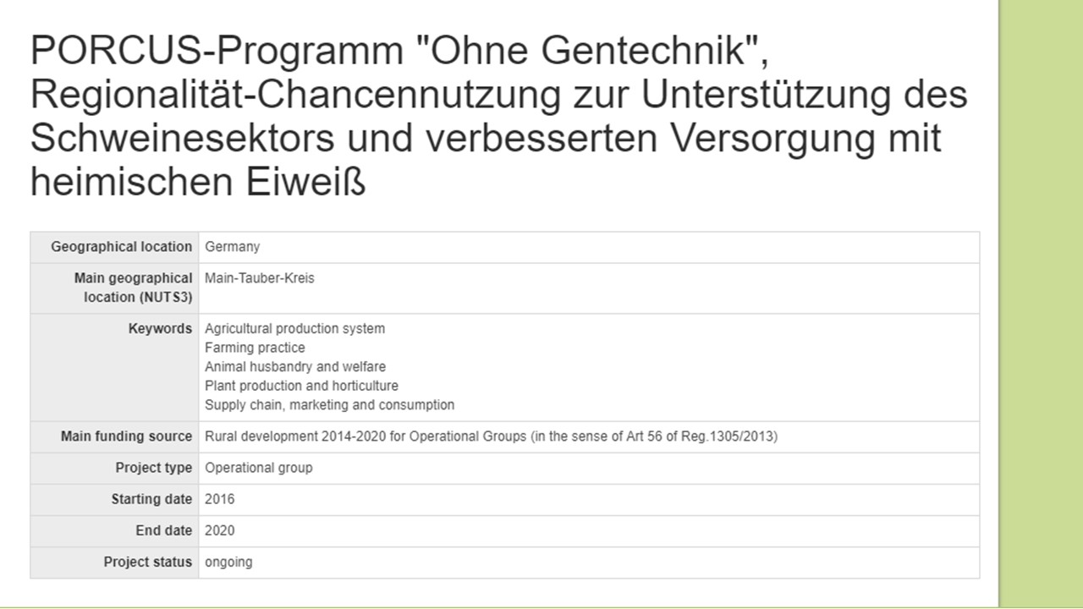
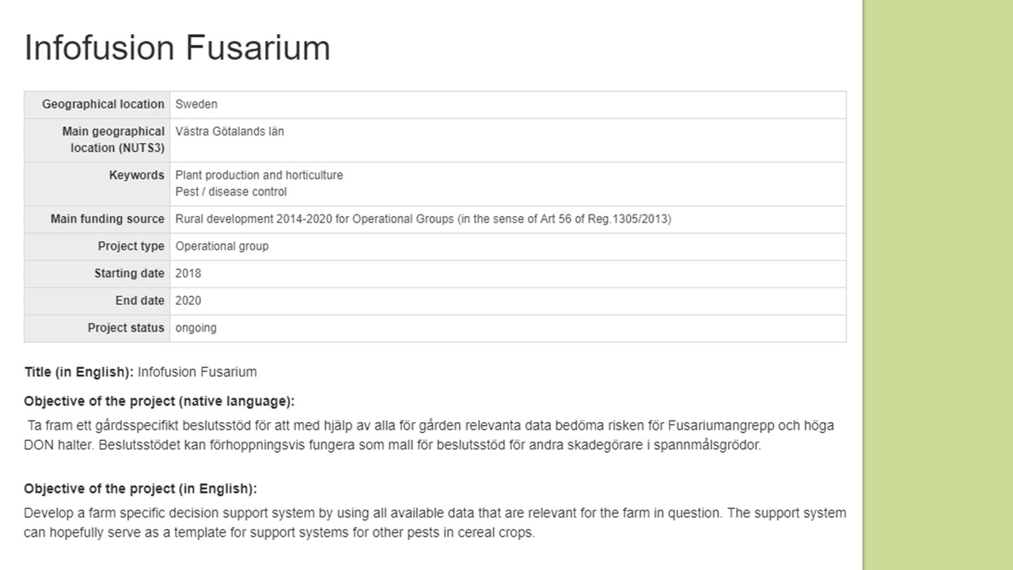
Operational Groups – get connected
Germany
Dealing with the supply of protein in pig sector and genetically unmodified production - cultivation of regional genetic free protein crops for feed
Sweden
Develop a farm-specific decision support system by using all available data that is relevant for the farm at stake

Slide 25
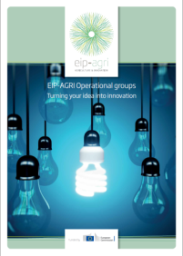
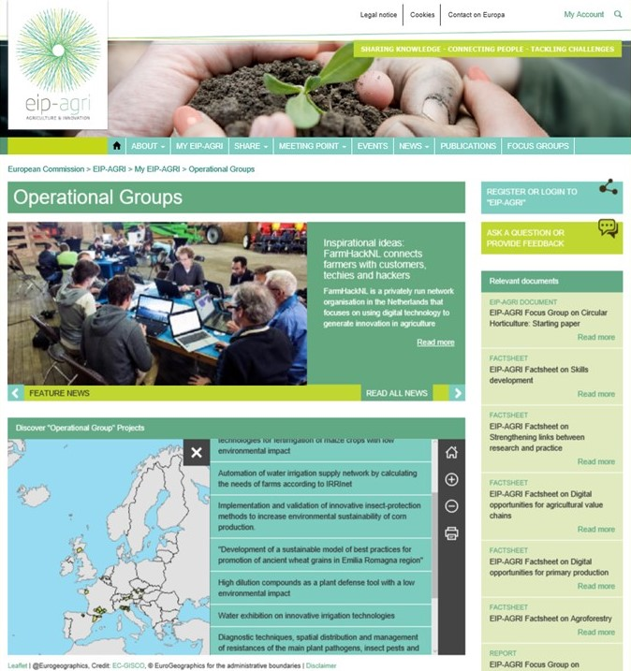
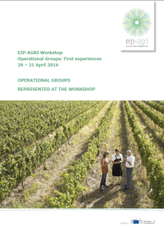
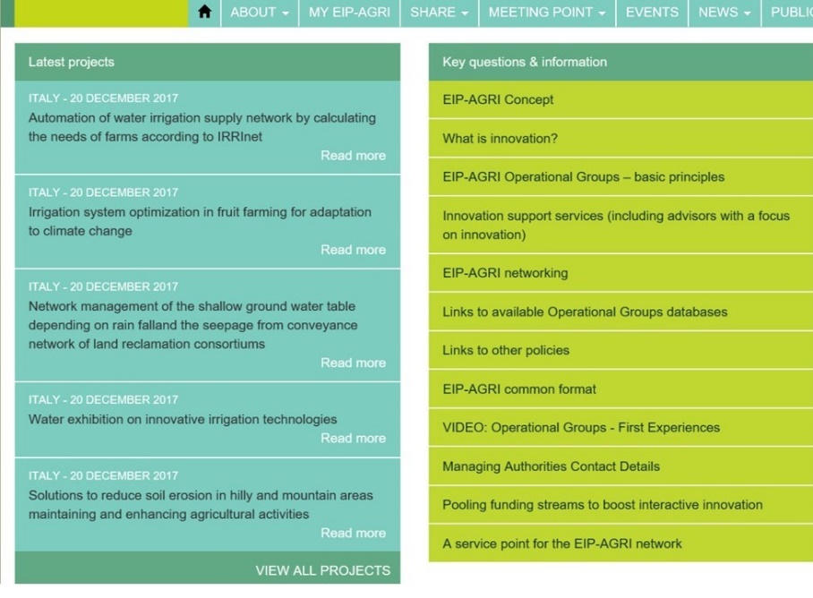
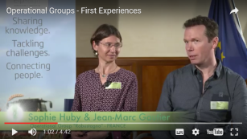
More information on OGs - explore the EIP Website
OG brochures
http://ec.europa.eu/eip/agriculture/en/content/eip-agri-brochure-operational-groups-update-2016
OG Dedicated Area
OG leaflet
http://ec.europa.eu/eip/agriculture/en/content/eip-agri-workshop-operational-groups-first-experiences
Unique EU repository of contacts and practice abstracts
OG Video
http://ec.europa.eu/eip/agriculture/en/my-eip-agri/operational-groups
https://youtu.be/7WhhGIocMO8

Slide 26
NOW - What can you do?
Register for the EIP-AGRI newsletter and website now!
Share experiences in respect to OG project(s)
Network and collaborate with other innovative projects
Participate in EIP-AGRI events (invitation / call)
Apply for the EIP-AGRI Focus Groups

Slide 27
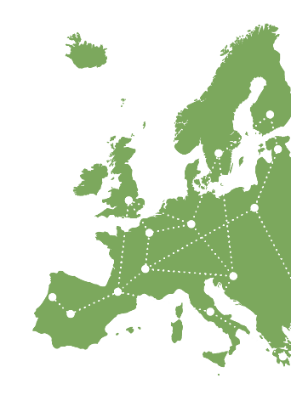
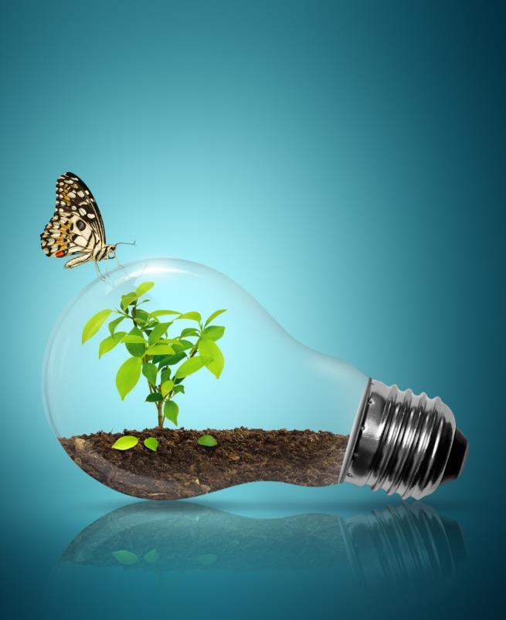
Thank you for your attention!
servicepoint@eip-agri.eu
+32 2 543 73 48
EIP-AGRI Service Point
Koning Albert II-laan 15
Conscience Building
1210 Brussel
Belgium
www.eip-agri.eu
Register today!

